Slide 1
Chapter 5: CPU Scheduling

Slide 2
Outline
Basic Concepts
Scheduling Criteria
Scheduling Algorithms
Thread Scheduling
Multi-Processor Scheduling
Real-Time CPU Scheduling
Operating Systems Examples
Algorithm Evaluation

Slide 3
Objectives
Describe various CPU scheduling algorithms
Assess CPU scheduling algorithms based on scheduling criteria
Explain the issues related to multiprocessor and multicore scheduling
Describe various real-time scheduling algorithms
Describe the scheduling algorithms used in the Windows, Linux, and Solaris operating systems
Apply modeling and simulations to evaluate CPU scheduling algorithms

Slide 4
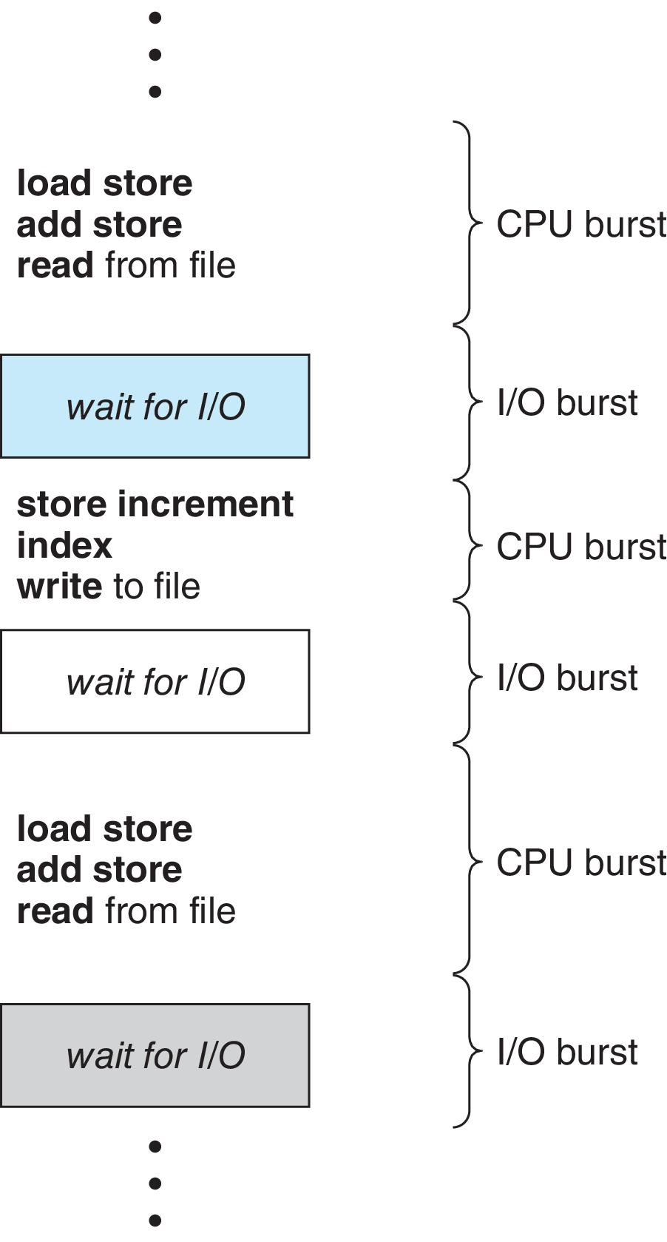
Basic Concepts
Maximum CPU utilization obtained with multiprogramming
CPU–I/O Burst Cycle – Process execution consists of a cycle of CPU execution and I/O wait
CPU burst followed by I/O burst
CPU burst distribution is of main concern

Slide 5
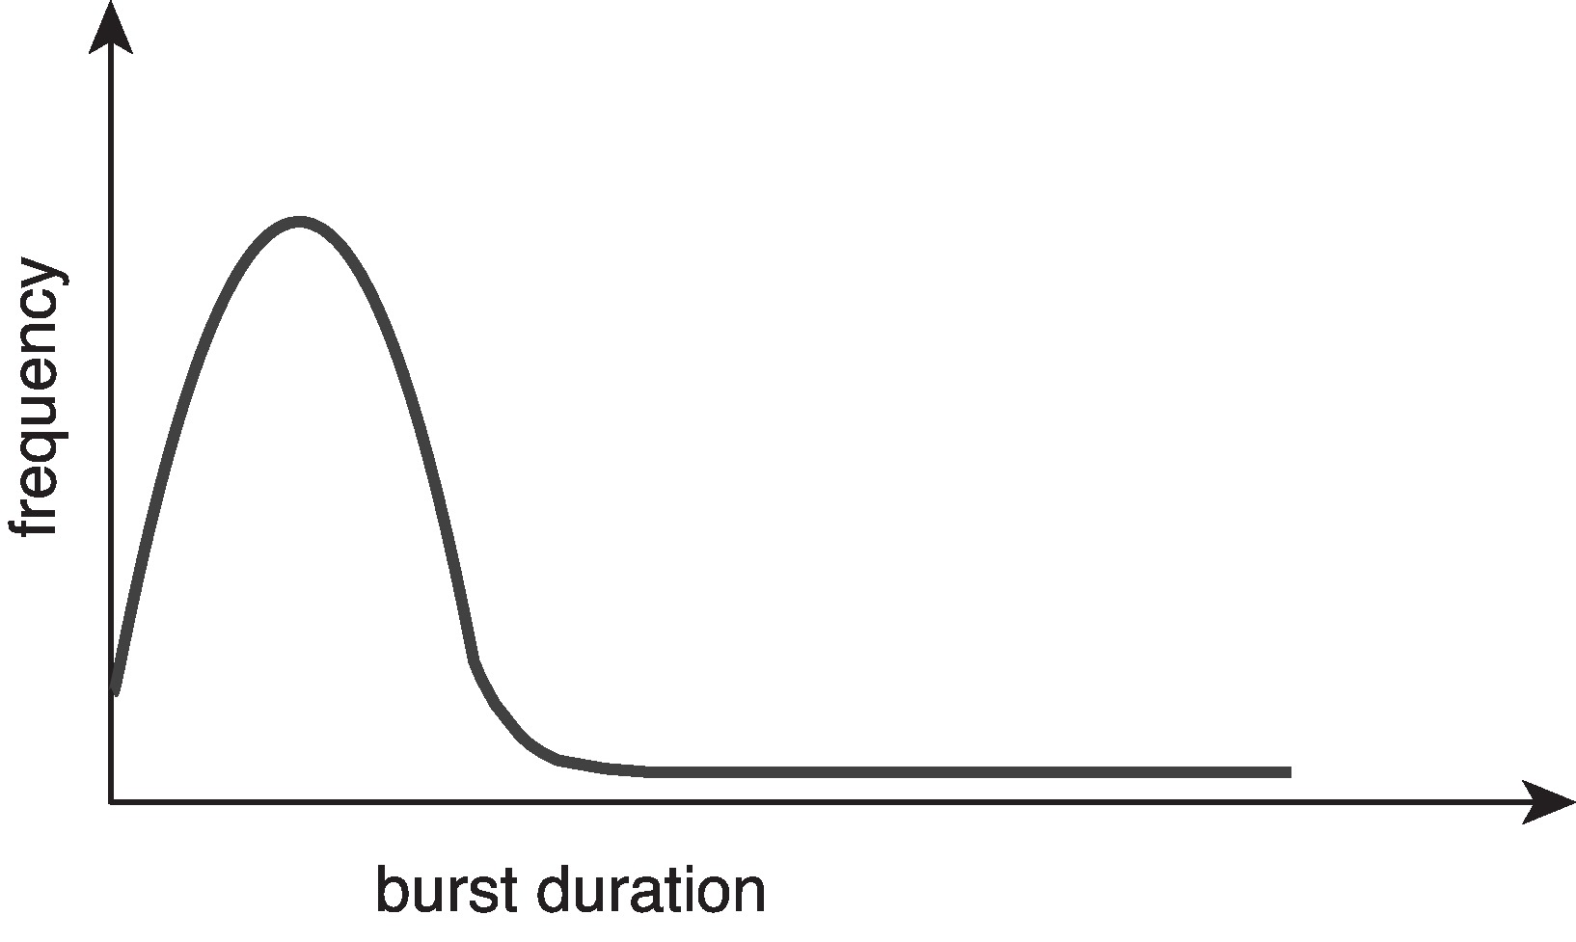
Histogram of CPU-burst Times
Large number of short bursts
Small number of longer bursts

Slide 6
CPU Scheduler
The CPU scheduler selects from among the processes in ready queue, and allocates a CPU core to one of them
  Queue may be ordered in various ways
CPU scheduling decisions may take place when a process:
  1. Switches from running to waiting state
  2. Switches from running to ready state
  3. Switches from waiting to ready
  Terminates
For situations 1 and 4, there is no choice in terms of scheduling. A new process (if one exists in the ready queue) must be selected for execution.
For situations 2 and 3, however, there is a choice.

Slide 7
Preemptive and Nonpreemptive Scheduling
When scheduling takes place only under circumstances 1 and 4, the scheduling scheme is nonpreemptive.
Otherwise, it is preemptive.
Under Nonpreemptive scheduling, once the CPU has been allocated to a process, the process keeps the CPU until it releases it either by terminating or by switching to the waiting state.
Virtually all modern operating systems including Windows, MacOS, Linux, and UNIX use preemptive scheduling algorithms.

Slide 8
Preemptive Scheduling and Race Conditions
Preemptive scheduling can result in race conditions when data are shared among several processes.
Consider the case of two processes that share data. While one process is updating the data, it is preempted so that the second process can run. The second process then tries to read the data, which are in an inconsistent state.
This issue will be explored in detail in Chapter 6.

Slide 9
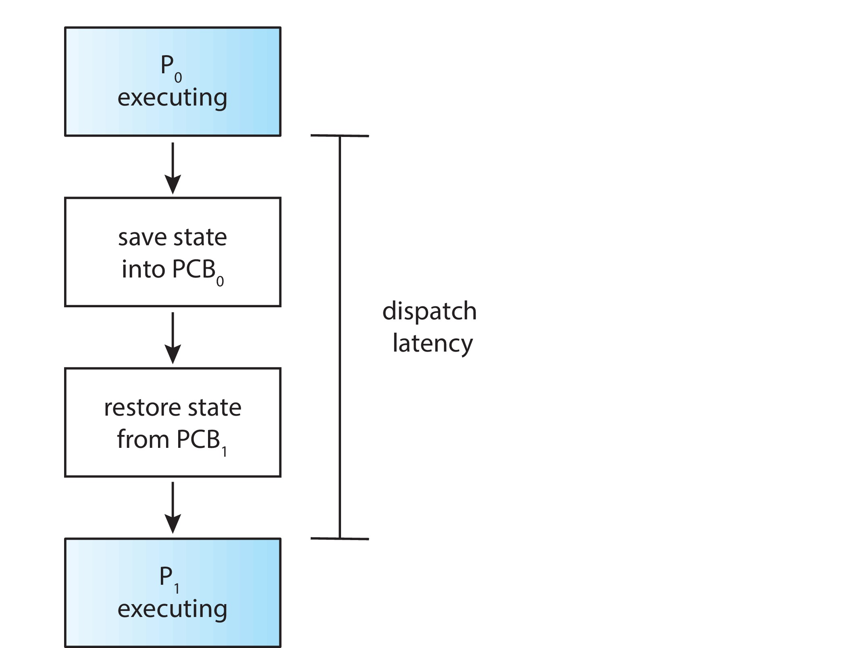
Dispatcher
Dispatcher module gives control of the CPU to the process selected by the CPU scheduler; this involves:
  Switching context
  Switching to user mode
  Jumping to the proper location in the user program to restart that program
Dispatch latency – time it takes for the dispatcher to stop one process and start another running

Slide 10
Scheduling Criteria
CPU utilization استخدام وحدة المعالجة المركزية– keep the CPU as busy as possible
Throughput الانتاجيه– # of processes that complete their execution per time unit
Turnaround time وقت التسليم– amount of time to execute a particular process
Waiting time وقت الانتظار– amount of time a process has been waiting in the ready queue
Response time زمن الاستجابة– amount of time it takes from when a request was submitted until the first response is produced.

Slide 11
Scheduling Algorithm Optimization Criteria
Max CPU utilization
Max throughput
Min turnaround time
Min waiting time
Min response time

Slide 12
Scheduling algorithms

Slide 13
First- Come, First-Served (FCFS) Scheduling
The algorithms: (1)

Slide 14
First- Come, First-Served (FCFS) Scheduling
Process Burst Time
P₁ 24
P₂ 3
P₃ 3
Suppose that the processes arrive in the order: P₁ , P₂ , P₃
The Gantt Chart for the schedule is:
Waiting time for P₁ = 0; P₂ = 24; P₃ = 27
Average waiting time: (0 + 24 + 27)/3 = 17

Slide 15
FCFS Scheduling (Cont.)
Suppose that the processes arrive in the order:
P₂ , P₃ , P₁
The Gantt chart for the schedule is:
Waiting time for P₁ = 6; P₂ = 0; P₃ = 3
Average waiting time: (6 + 0 + 3)/3 = 3
Much better than previous case
Convoy effect - short process behind long process
  Consider one CPU-bound and many I/O-bound processes

Slide 16
(2)
Shortest-Job-First (SJF) Scheduling

Slide 17
Shortest-Job-First (SJF) Scheduling
Associate with each process the length of its next CPU burst
  Use these lengths to schedule the process with the shortest time
SJF is optimal – gives minimum average waiting time for a given set of processes
The difficulty is knowing the length of the next CPU request
  Could ask the user

Slide 18
Shortest-Job-First (SJF) Scheduling
Associate with each process the length of its next CPU burst
  Use these lengths to schedule the process with the shortest time
SJF is optimal – gives minimum average waiting time for a given set of processes
Preemptive version called shortest-remaining-time-first
How do we determine the length of the next CPU burst?
  Could ask the user
  Estimate

Slide 19
Example of SJF
ProcessArriva l Time Burst Time
P₁ 0.0 6
P₂ 2.0 8
P₃ 4.0 7
P₄ 5.0 3
SJF scheduling chart
Average waiting time = (3 + 16 + 9 + 0) / 4 = 7

Slide 20

Determining Length of Next CPU Burst
Can only estimate the length – should be similar to the previous one
  Then pick process with shortest predicted next CPU burst
Can be done by using the length of previous CPU bursts, using exponential averaging
Commonly, α set to ½

Slide 21
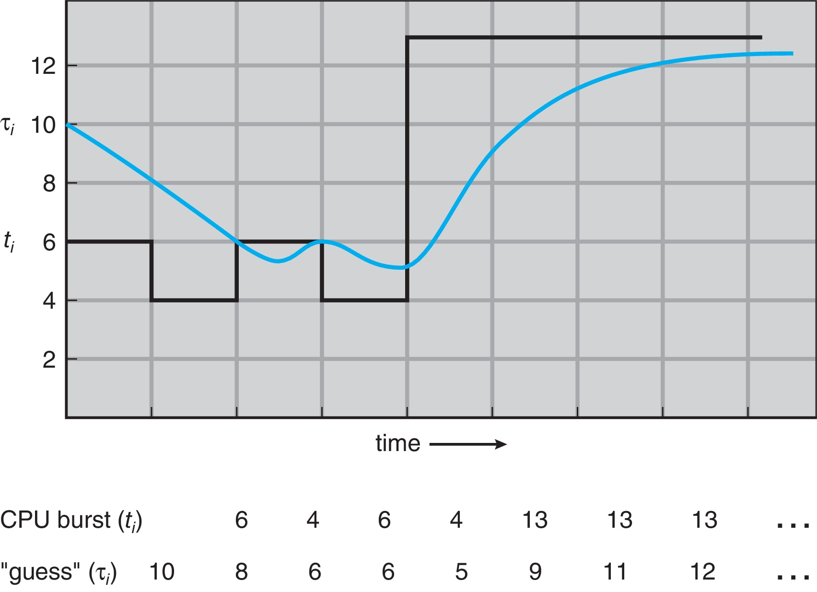
Prediction of the Length of the Next CPU Burst

Slide 22
Examples of Exponential Averaging
α =0
  τ_{n+1} = τ_{n}
  Recent history does not count
α =1
  τ_{n+1} = α t_{n}
  Only the actual last CPU burst counts
If we expand the formula, we get:
    τ_{n+1} = α t_{n}+(1 - α)α t_{n} ₋₁ + …
    +(1 - α )^{j} α t_{n} _{-j} + …
    +(1 - α )^{n +1} τ₀
Since both α and (1 - α) are less than or equal to 1, each successive term has less weight than its predecessor

Slide 23
Example of Shortest-remaining-time-first
Now we add the concepts of varying arrival times and preemption to the analysis
ProcessA arri Arrival TimeT Burst Time wait time
P₁ 0 8 9 (10-1)
P₂ 1 4 0 (1-1)
P₃ 2 9 15 (17-2)
P₄ 3 5 2 (5-3)
Preemptive SJF Gantt Chart
Average waiting time = [(10-1)+(1-1)+(17-2)+(5-3)]/4 = 26/4 = 6.5

Slide 24
Round Robin (RR)
Each process gets a small unit of CPU time (time quantum q), usually 10-100 milliseconds. After this time has elapsed, the process is preempted and added to the end of the ready queue.
If there are n processes in the ready queue and the time quantum is q, then each process gets 1/n of the CPU time in chunks of at most q time units at once. No process waits more than (n-1)q time units.
Timer interrupts every quantum to schedule next process
Performance
  q large ⇒ FIFO
  q small ⇒ q must be large with respect to context switch, otherwise overhead is too high

Slide 25
Example of RR with Time Quantum = 4
Process Burst Time waiting time response time turnaround time
P₁ 24 6 (26-20) 0 30
P₂ 3 4 4 7
P₃ 3 7 7 10
Average 17/3=5.6 11/3=3.6 47/3=10.6
The Gantt chart is:
Typically, higher average turnaround than SJF, but better response
  No process waits more than (n-1)q time units
q should be large compared to context switch time
  q usually 10 milliseconds to 100 milliseconds,
  Context switch < 10 microseconds

Slide 26
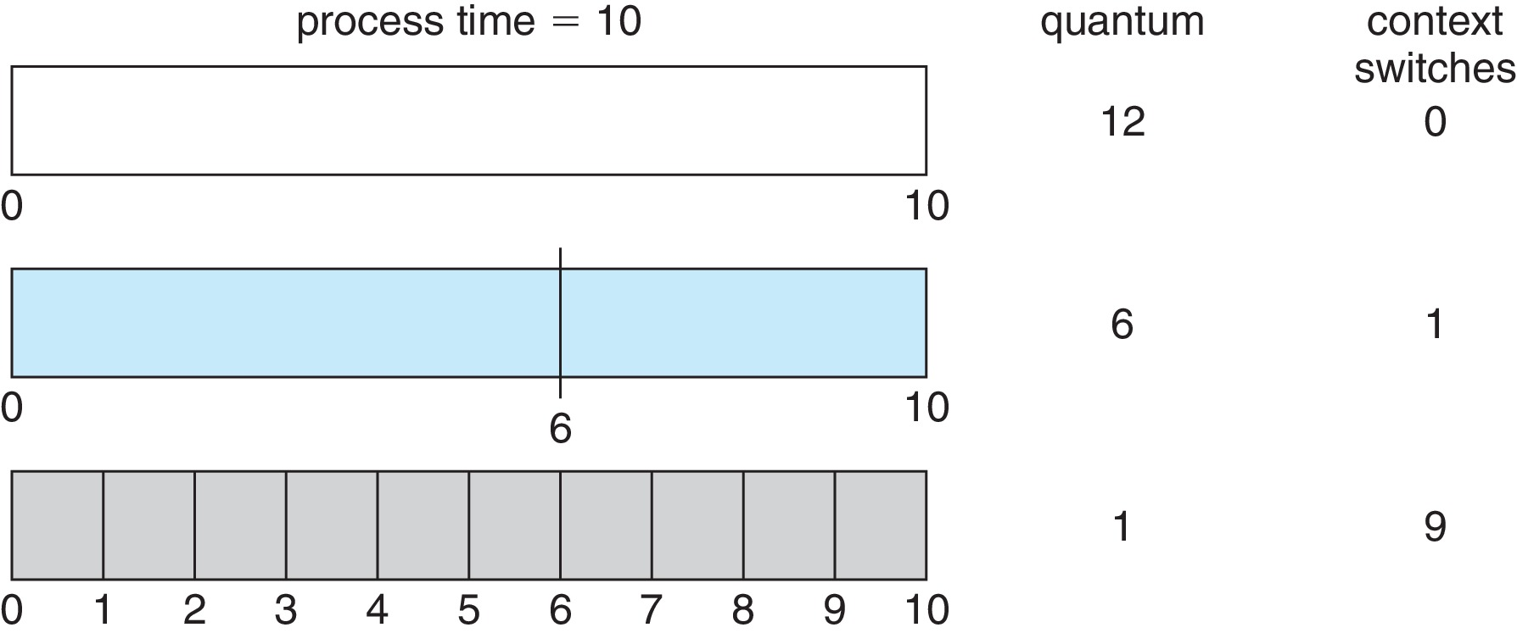
Time Quantum and Context Switch Time

Slide 27
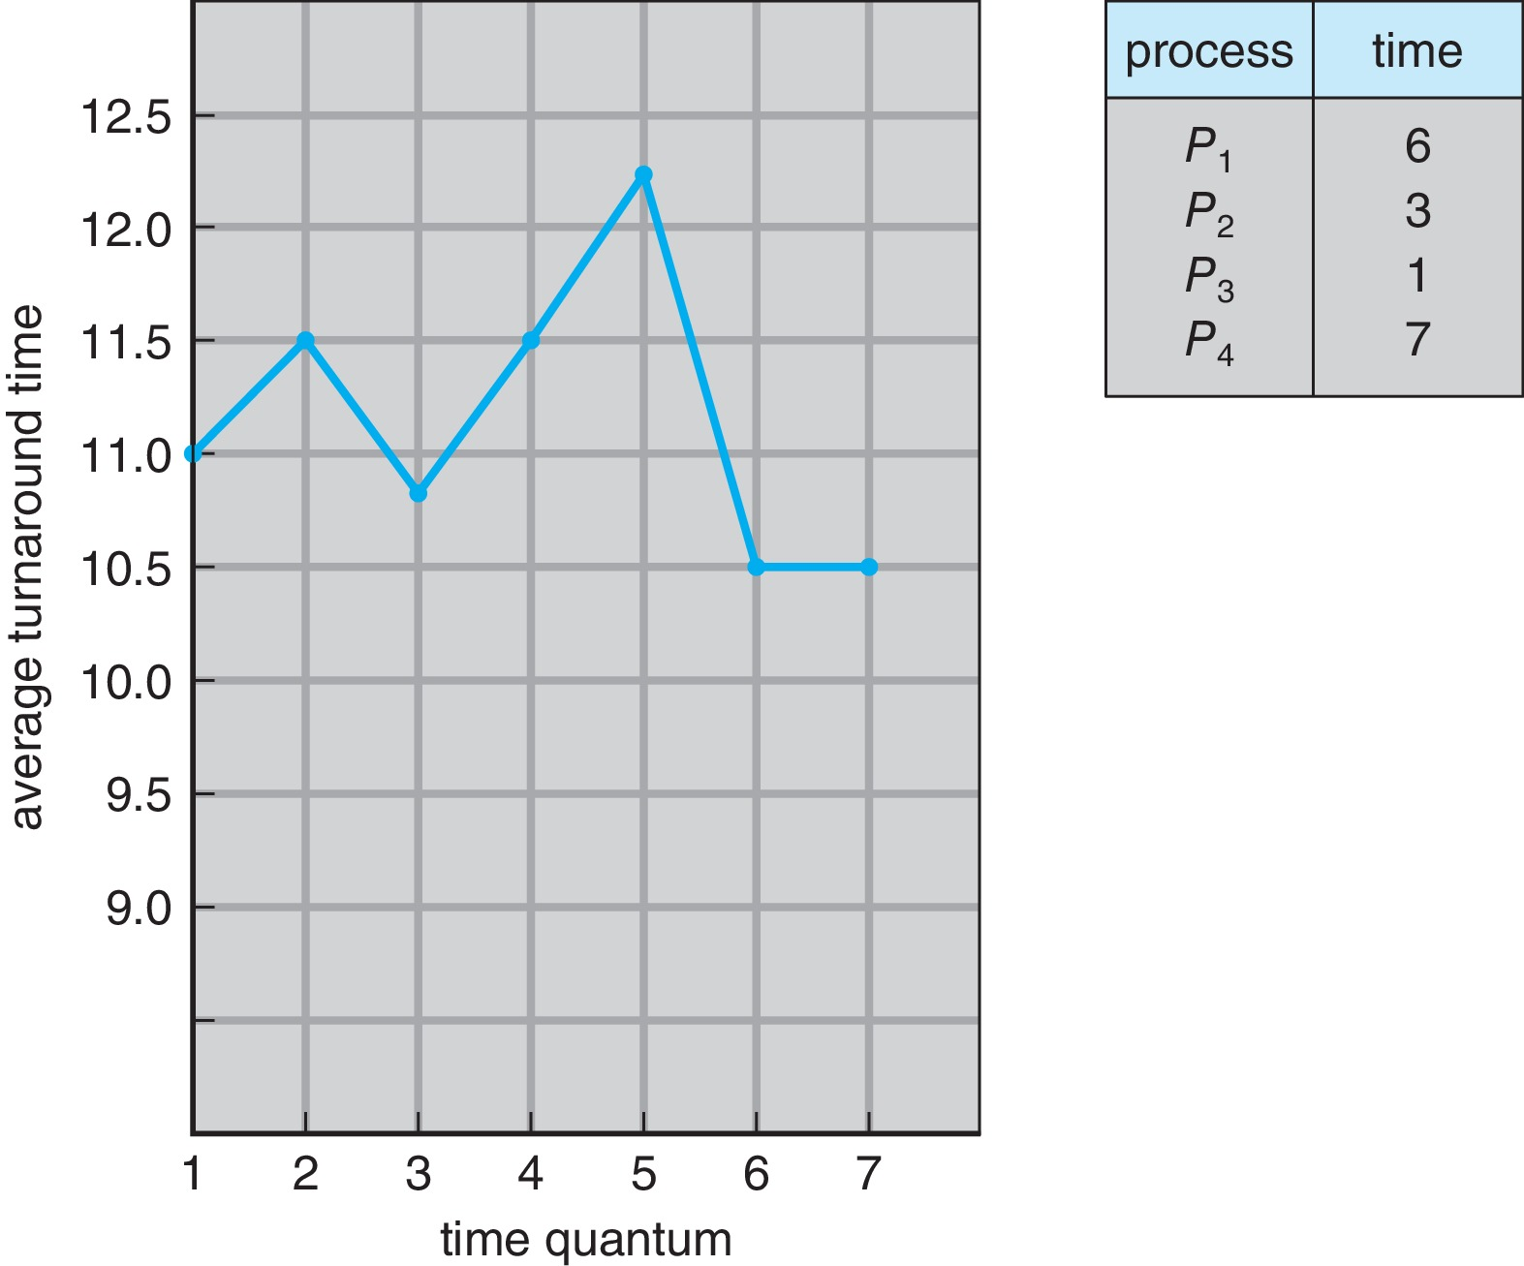
Turnaround Time Varies With The Time Quantum
80% of CPU bursts should be shorter than q
For q=7 average turnaround =(6+9+10+17)/4=42/4=10.5

Slide 28
Turnaround Time Varies With The Time Quantum
As we can see in above figure, the average turnaround time of a set of processes does not necessarily improved as the time-quantum size increase.
The average turnaround time can be improved if most processes finish their next CPU burst in single time quantum.
  Example, if we have 3 processes with 10-time unit, and quantum=1 then average turnaround =29 . But if time quantum=10 the average turnaround time drops to 20.
If time quantum is too large, RR scheduling degenerates to FCFS policy, .
80% of CPU bursts should be shorter than q

Slide 29
Priority Scheduling
A priority number (integer) is associated with each process
The CPU is allocated to the process with the highest priority (smallest integer ≡ highest priority)
  Preemptive
  Nonpreemptive
SJF is priority scheduling where priority is the inverse of predicted next CPU burst time
Problem ≡ Starvation – low priority processes may never execute
Solution ≡ Aging – as time progresses increase the priority of the process

Slide 30
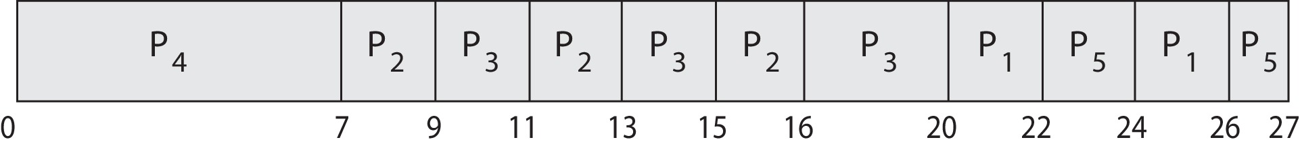
Priority Scheduling w/ Round-Robin
ProcessA arri Burst TimeT Priority
P₁ 4 3
P₂ 5 2
P₃ 8 2
P₄ 7 1
P₅ 3 3
Run the process with the highest priority. Processes with the same priority run round-robin
Gantt Chart with time quantum = 2

Slide 31
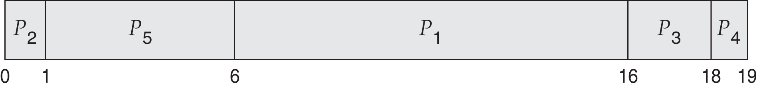
Example of Priority Scheduling
ProcessA arri Burst TimeT Priority
P₁ 10 3
P₂ 1 1
P₃ 2 4
P₄ 1 5
P₅ 5 2
Priority scheduling Gantt Chart
Average waiting time = 8.2 =(6+0+16+18+1)/5=41/5

Slide 32
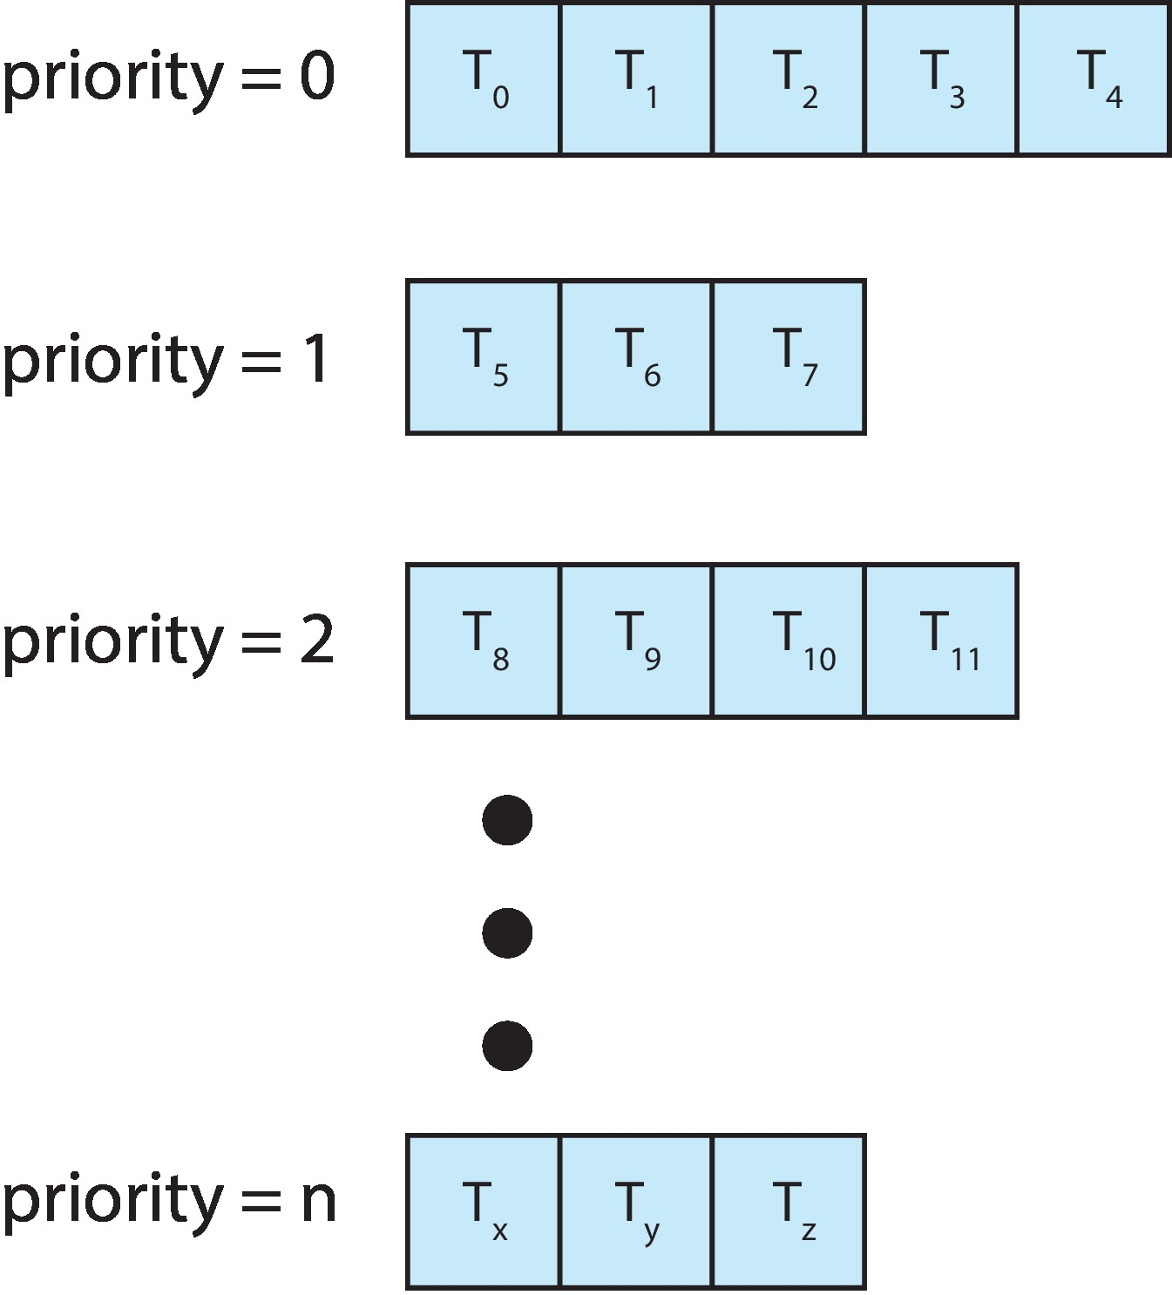
Multilevel Queue
With priority scheduling, have separate queues for each priority.
Schedule the process in the highest-priority queue!

Slide 33
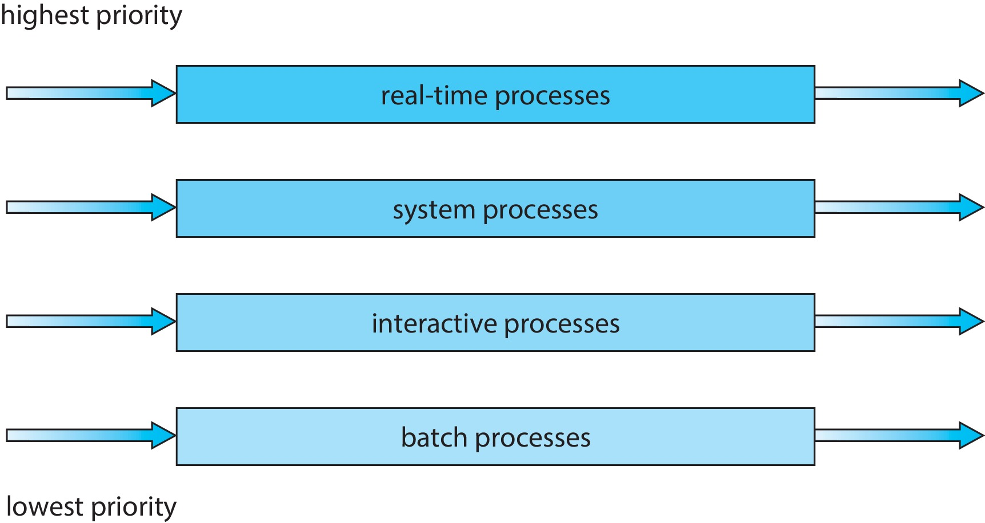
Multilevel Queue
Prioritization based upon process type

Slide 34
Multilevel Queue
1.Each queue has absolute priority over lower-priority queues.
No process in the batch queue, for example, could run unless the queues for real-time processes, system processes, and interactive processes were all empty.
  If an interactive process entered the ready queue while a batch process was running, the batch process would be preempted.
2. Another possibility is to time-slice among the queues. Here, each queue gets a certain portion of the CPU time, which it can then schedule among its various processes.
For instance, in the foreground –background queue example,
  the foreground queue can be given 80 percent of the CPU time for RR scheduling among its processes,
  while the background queue receives 20 percent of the CPU to give to its processes on an FCFS basis.
Notes:
Multilevel Queue.in the case :Each queue has absolute priority over lower-priority queues
No process in low priority queue, could run unless the queues for high priority queue, as system processes, and interactive processes were all empty.(answer)
each queue gets a certain portion of the CPU time, which it can then schedule among its various processes.

Slide 35
Multilevel Feedback Queue
A process can move between the various queues.
Multilevel-feedback-queue scheduler defined by the following parameters:
  Number of queues
  Scheduling algorithms for each queue
  Method used to determine when to upgrade a process
  Method used to determine when to demote a process
  Method used to determine which queue a process will enter when that process needs service
Aging can be implemented using multilevel feedback queue

Slide 36
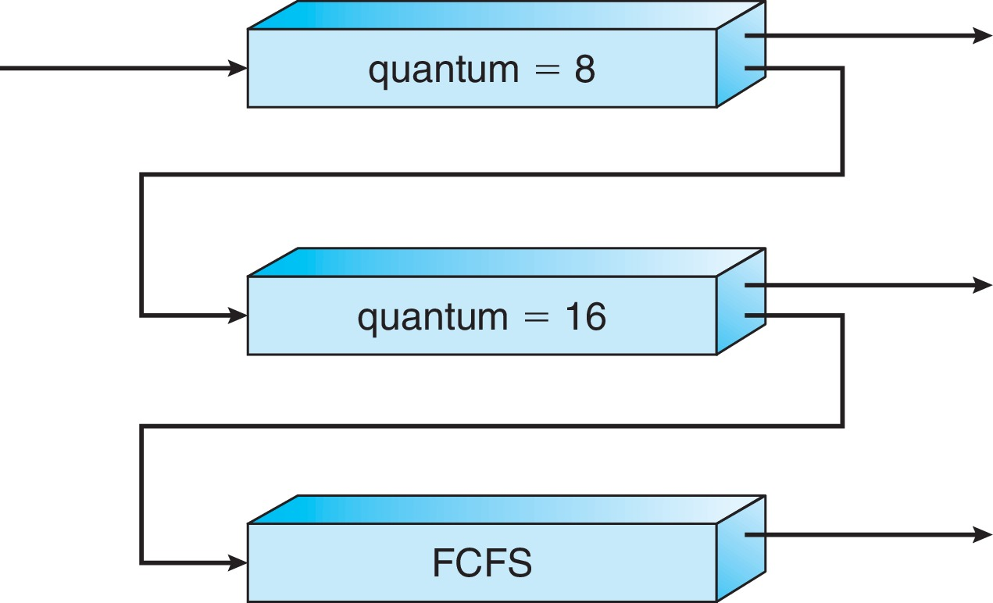
Example of Multilevel Feedback Queue
Three queues:
  Q₀ – RR with time quantum 8 milliseconds
  Q₁ – RR time quantum 16 milliseconds
  Q₂ – FCFS
Scheduling
  A new process enters queue Q₀ which is served in RR
    When it gains CPU, the process receives 8 milliseconds
    If it does not finish in 8 milliseconds, the process is moved to queue Q₁
  At Q₁ job is again served in RR and receives 16 additional milliseconds
    If it still does not complete, it is preempted and moved to queue Q₂

Slide 37
Thread Scheduling
Distinction between user-level and kernel-level threads
When threads supported, threads scheduled, not processes
Many-to-one and many-to-many models, thread library schedules user-level threads to run on LWP
  Known as process-contention scope (PCS) since scheduling competition is within the process
  Typically done via priority set by programmer
Kernel thread scheduled onto available CPU is system-contention scope (SCS) – competition among all threads in system

Slide 38
Pthread Scheduling
API allows specifying either PCS or SCS during thread creation
  PTHREAD_SCOPE_PROCESS schedules threads using PCS scheduling
  PTHREAD_SCOPE_SYSTEM schedules threads using SCS scheduling
Can be limited by OS – Linux and macOS only allow PTHREAD_SCOPE_SYSTEM

Slide 39
Pthread Scheduling API
#include <pthread.h>
#include <stdio.h>
#define NUM_THREADS 5
int main(int argc, char *argv[]) {
int i, scope;
pthread_t tid[NUM THREADS];
pthread_attr_t attr;
/* get the default attributes */
pthread_attr_init(&attr);
/* first inquire on the current scope */
if (pthread_attr_getscope(&attr, &scope) != 0)
fprintf(stderr, "Unable to get scheduling scope\n");
else {
if (scope == PTHREAD_SCOPE_PROCESS)
printf("PTHREAD_SCOPE_PROCESS");
else if (scope == PTHREAD_SCOPE_SYSTEM)
printf("PTHREAD_SCOPE_SYSTEM");
else
fprintf(stderr, "Illegal scope value.\n");
}

Slide 40
Pthread Scheduling API
/* set the scheduling algorithm to PCS or SCS */
pthread_attr_setscope(&attr, PTHREAD_SCOPE_SYSTEM);
/* create the threads */
for (i = 0; i < NUM_THREADS; i++)
pthread_create(&tid[i],&attr,runner,NULL);
/* now join on each thread */
for (i = 0; i < NUM_THREADS; i++)
pthread_join(tid[i], NULL);
}
/* Each thread will begin control in this function */
void *runner(void *param)
{
/* do some work ... */
pthread_exit(0);
}

Slide 41
5.5
Multiple-Processor Scheduling

Slide 42
5.5.Multiple-Processor Scheduling
CPU scheduling more complex when multiple CPUs are available
If multiple CPUs are available, load sharing, where multiple threads may run in parallel, becomes possible, however scheduling issues become correspondingly more complex.
Multiprocess may be any one of the following architectures:
  Multicore CPUs
  Multithreaded cores
  Non-uniform memory access (NUMA) systems
  Heterogeneous multiprocessing المعالجة المتعددة غير المتجانسة
Notes:
a processor can access its own local memory faster than non-local memory (memory local to another processor or memory shared between processors).

Slide 43
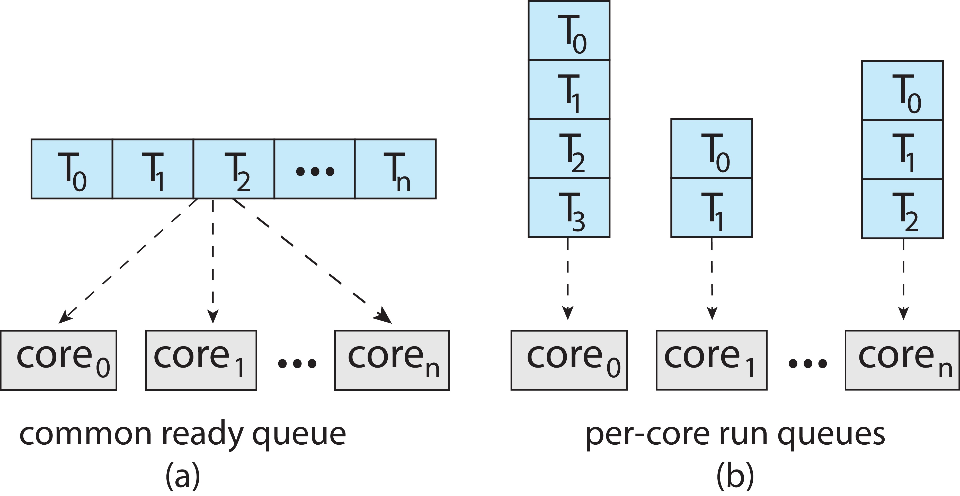
5.5.1 Approaches to Multiple-Processor Scheduling
1. Asymmetric multiprocessing (AMP) –
  Only one processor (master) accesses the system data structures (scheduling decisions, i/o processing, etc), reducing the need for data sharing, others are slaves
  Problems: high load on master – bottle-neck problem
  2. Symmetric multiprocessing (SMP) –
  All threads may be in a common ready queue (a)
  Each processor may have its own private queue of threads (b)

Slide 44
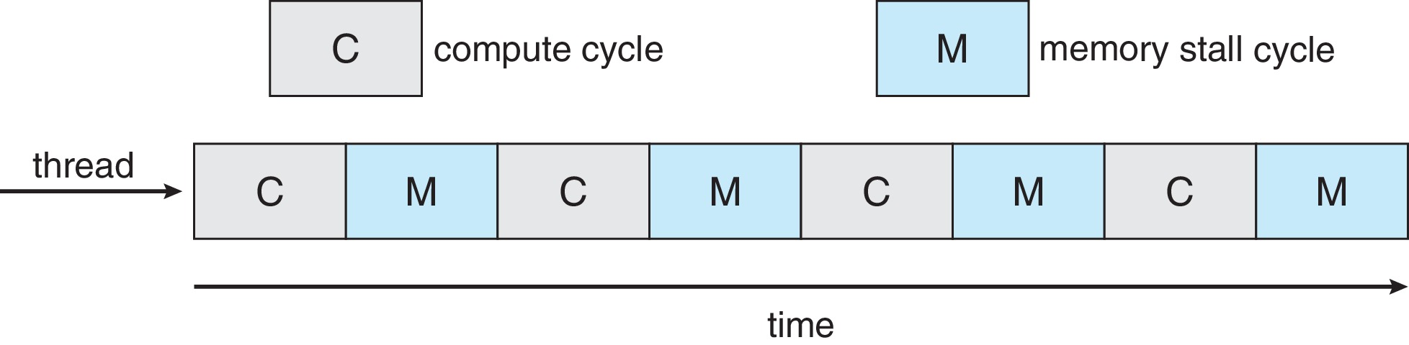
5.5.2 Multicore Processors(+)
Recent trend to place multiple processor cores on same physical chip
Each core maintains its architectural state and thus appears to the operating system to be a separate logical CPU.
Faster and consumes less power
They may complicate scheduling issues.
  Memory stall :when a processor accesses memory, it spends a significant amount of time waiting for the data to become available. Because modern processors operate at much faster speeds than memory.
  memory stall can also occur because of a cache miss
Figure :the processor can spend up to 50 percent on a memory stall

Slide 45
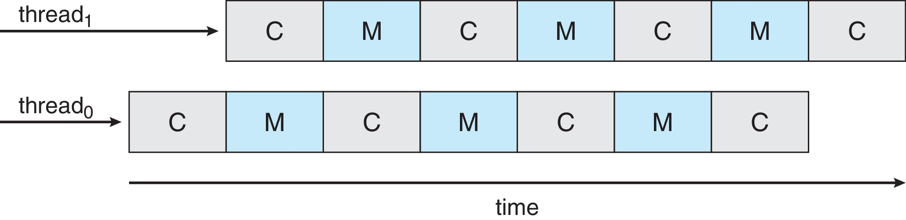
Multithreaded Multicore System(+)
Multiple threads per core also growing
  Takes advantage of memory stall to make progress on another thread while memory retrieve happens
Each core has > 1 hardware threads.
If one thread has a memory stall, switch to another thread!
Figure: illustrates a dual-threaded processing core on which the execution of thread 0 and the execution of thread 1 are interleaved.

Slide 46
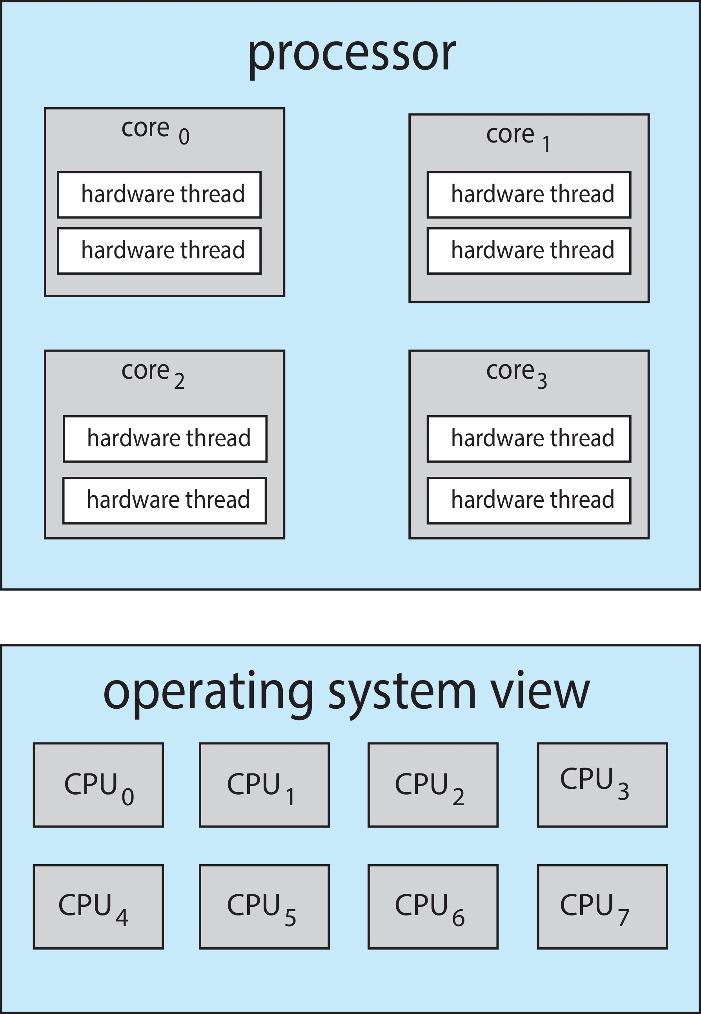
Multithreaded Multicore System Chip-multithreading
Some system in which, each hardware thread maintains its architectural state,
  such as instruction pointer and register set, and thus appears as a logical CPU that is available to run a software thread.
This is knowing as Chip-multithreading (CMT) assigns each core multiple hardware threads.
On a quad-core system رباعي with 2 hardware threads per core, the operating system sees 8 logical processors.
Intel processors use the term hyper-threading (also known as simultaneous multithreading or SMT) to describe assigning multiple hardware threads to a single processing core.
  ex. i7—support two threads per core, with 8 cores it sees 16 logical CPUs.
  the Oracle Sparc M7 processor supports 8 threads per core, with 8 cores it sees 64 logical CPUs.

Slide 47
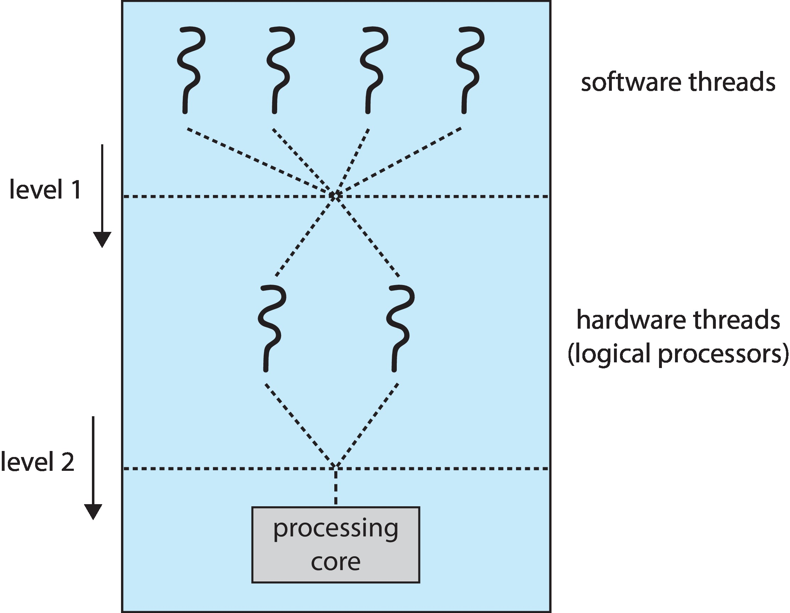
Multithreaded Multicore System Chip-multithreading
The resources of the physical core (such as caches and pipelines) must be shared among its hardware threads, and therefore a processing core can only execute one hardware thread at a time.
Thus, a multithreaded, multicore processor requires two different levels of scheduling figure explains a dual-threaded processing core.
Two levels of scheduling:
  1.The operating system deciding which software thread to run on a logical CPU.
  2.How each core decides which hardware thread to run on the physical core.

Slide 48
Multiple-Processor Scheduling – Load Balancing
If Symmetric multiprocessing (SMP), need to keep all CPUs loaded for efficiency
Load balancing attempts to keep workload evenly distributed by:
  Push migration – periodic task checks load on each processor, and if found pushes task from overloaded CPU to other CPUs
  Pull migration – idle processors pulls waiting task from busy processor

Slide 49
Multiple-Processor Scheduling – Processor Affinity
When a thread has been running on one processor, the cache contents of that processor stores the memory accesses by that thread.
We refer to this as a thread having affinity for a processor (i.e., “processor affinity”)
Load balancing may affect processor affinity as a thread may be moved from one processor to another to balance loads, yet that thread loses the contents of what it had in the cache of the processor it was moved off, types:
  Soft affinity – the operating system attempts to keep a thread running on the same processor, but no guarantees.
  Hard affinity – allows a process to specify a set of processors it may run on.

Slide 50
Multiple-Processor Scheduling vs. Processor Affinity -NUMA and CPU Scheduling(+)
If the operating system is NUMA-aware, it will assign memory closes to the CPU the thread is running on.
In this type, load balancing often counteracts يقاومthe benefits of processor affinity
  the benefit of keeping a thread running on the same processor is that the thread can take advantage of its data being in that processor’s cache memory.
  Balancing loads by moving a thread from one processor to another removes this benefit.
  Similarly, migrating a thread between processors may incurتتحمل a penalty on NUMA systems, where a thread may be moved to a processor that requires longer memory access times.
In other words, there is a natural tension between load balancing and minimizing memory access times.بمعنى آخر ، هناك شدعكسي بين موازنة الحمل وتقليل أوقات الوصول إلى الذاكرة.
Notes:
Tension :تكلفه او جهد

Slide 51
lecture

Slide 52
5.6.Real-Time CPU Scheduling
In this section, we explore several issues related to process scheduling in both soft and hard real-time operating systems Can present obvious challenges
Soft real-time systems – Critical real-time tasks have the highest priority, but no guarantee as to when tasks will be scheduled
Hard real-time systems – task must be serviced by its deadline

Slide 53
issues
5.6.Real-Time CPU Scheduling -

Slide 54
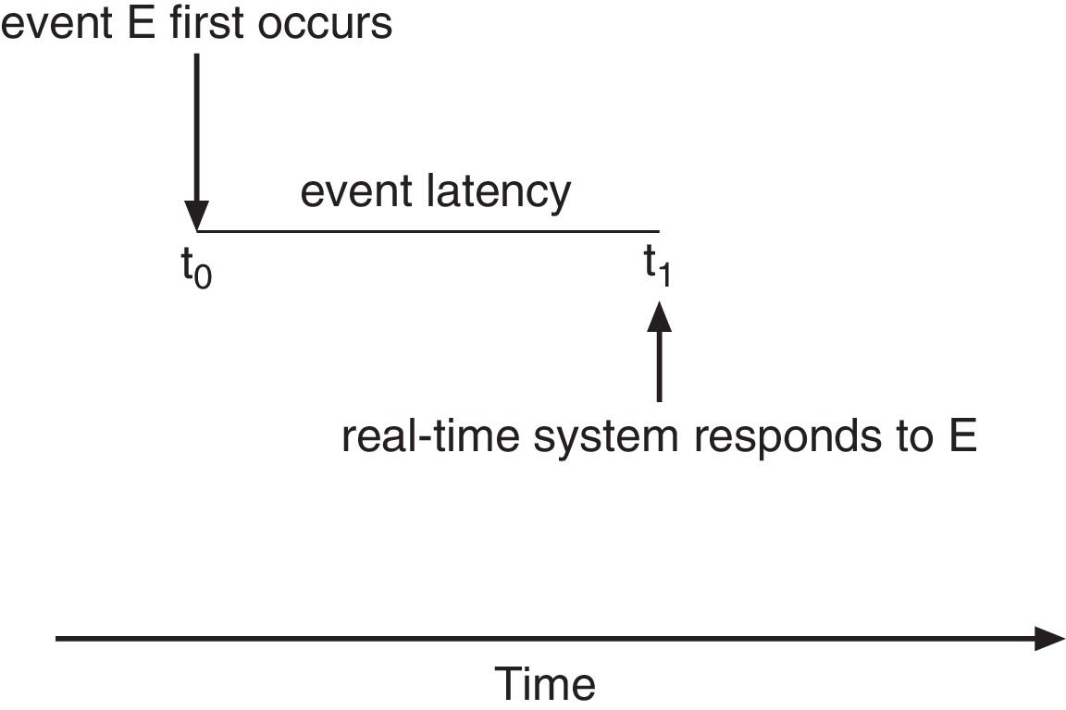
5.6.1 Minimizing Latencyتقليل زمن الوصول
Event latency – the amount of time that elapses from when an event occurs to when it is serviced.
Two types of latencies affect performance
Interrupt latency –time from arrival of interrupt to start of routine that services interrupt وقت بد المقاطعه
Dispatch latency - time for schedule to take current process off CPU and switch to another زمن التبديل

Slide 55
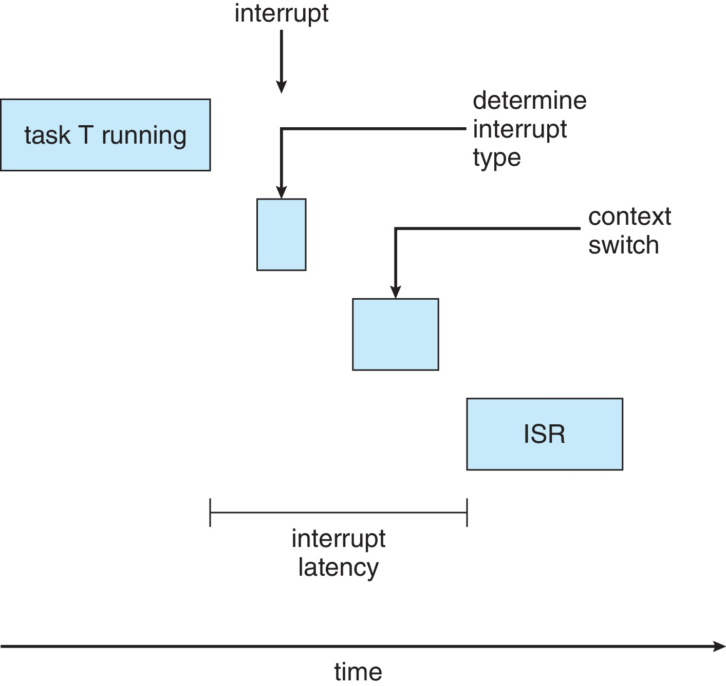
1.Interrupt Latency
Notes:
ISR( interrupt service routine)

Slide 56
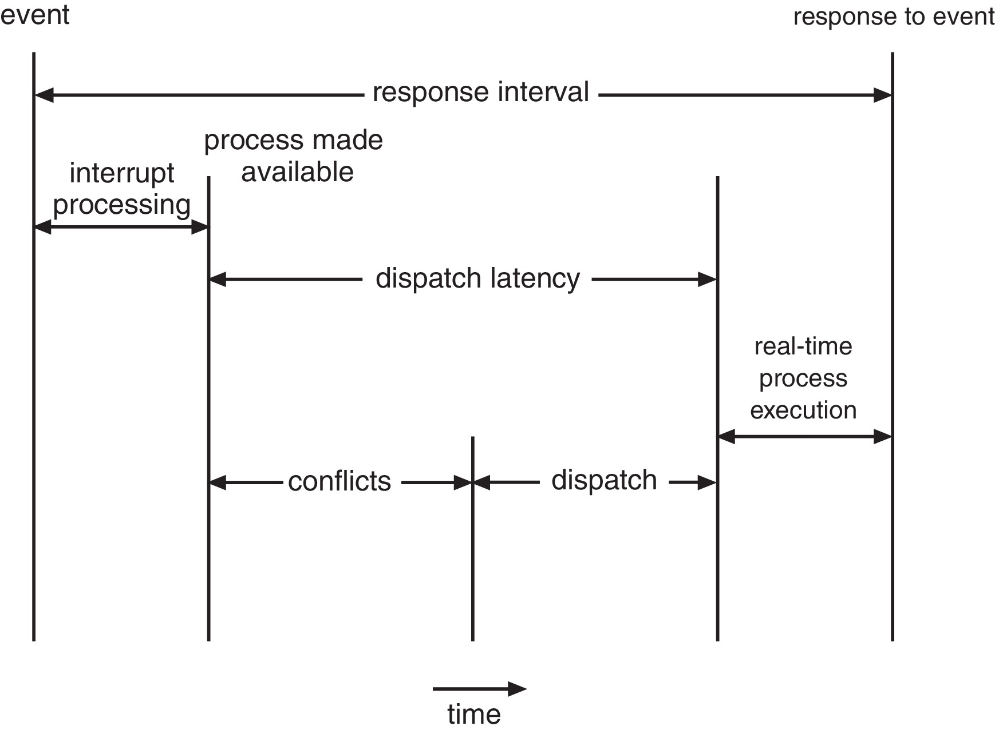
2.Dispatch Latency
the real-time operating systems minimize this latency as well
Conflict phase of dispatch latency:
  Preemption of any process running in kernel mode
  Release by low-priority process of resources needed by high-priority processes
Following the conflict phase, the dispatch phase schedules the high-priority process onto an available CPU.

Slide 57
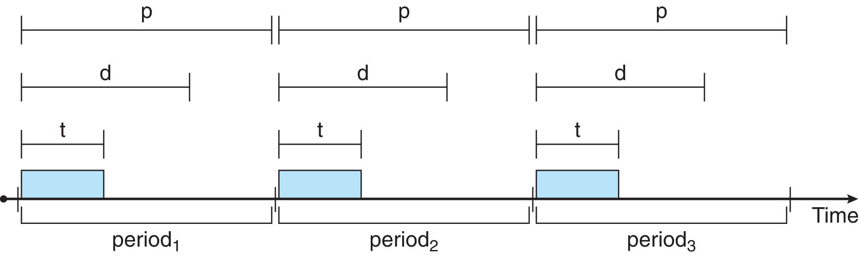
5.6.2.Priority-based Scheduling
The most important feature of a real-time operating system is to respond immediately to a real-time process as soon as that process requires the CPU.الميزة الأكثر أهمية لنظام التشغيل في الوقت الفعلي هي الاستجابة الفورية لعملية في الوقت الفعلي بمجرد أن تتطلب هذه العملية وحدة المعالجة المركزية.
For real-time scheduling, scheduler must support preemptive, priority-based scheduling
  But only guarantees soft real-time
For hard real-time must also provide ability to meet deadlines
Processes have new characteristics: periodic ones require CPU at constant intervals عدد مرات حاجة العمليه للنتفذ خلال الفتره المحدده
  Has processing time t, deadline d, period p
  0 ≤ t ≤ d ≤ p; . Rate of periodic task is 1/p
Notes:
The most important feature of a real-time operating system is to respond immediately
to a real-time process as soon as that process requires the CPU.
For hard real-time must also provide ability to meet deadlines

Slide 58
5.6.2.Priority-based Scheduling next
There is unusual about this form of scheduling
  announcing its deadline requirements to the scheduler.
  Then, using an admission-control algorithm, the scheduler :
    It either admits the process, guaranteeing that the process will complete on time,
    or rejects the request as impossible if it cannot guarantee that the task will be serviced by its deadline.
Notes:
The most important feature of a real-time operating system is to respond immediately
to a real-time process as soon as that process requires the CPU.
For hard real-time must also provide ability to meet deadlines

Slide 59
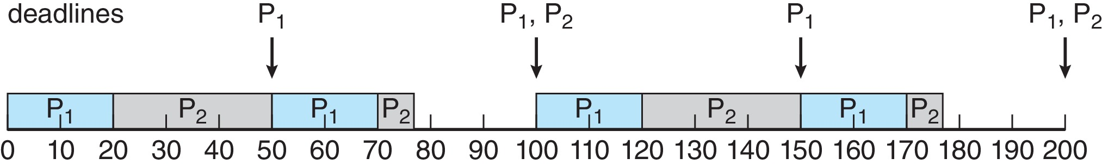
5.6.3.Rate Monotonic Scheduling
The rate-monotonic scheduling algorithm schedules periodic tasks using a static priority policy with preemption. تقوم خوارزمية الجدولة الرتيبة ذات المعدل بجدولة المهام الدورية باستخدام سياسة أولوية ثابتة مع الاستباقية.
  Idea:If a lower-priority process is running and a higher-priority process becomes available to run, it will preempt the lower-priority process. Upon entering the system, each periodic task is assigned a priority inversely based on its period. عند الدخول إلى النظام ، يتم تعيين أولوية لكل مهمة دورية عكسيا بناء على فترتها.
  As the shorter the periodمرحلة زمنية, the higher the priority; the longer the period, the lower the priority
So,A priority is assigned based on the inverse of its period
  Shorter periods = higher priority;
  Longer periods = lower priority
  P₁ is assigned a higher priority than P₂. where, p1 = 50 and p2 = 100.
T1 of p1=20
T2 of p2=35
Notes:
P=100

Slide 60
Rate-monotonic scheduling – GeeksforGeeks
reference

Slide 61
Rate Monotonic Scheduling
Example : We have two processes, P1 and P2.
The periods for P1 and P2 as, p1 = 50 and p2 = 100.
The processing times are t1 = 20 for P1 and t2 = 35 for P2.
The deadline for each process requires that it complete its CPU burst by the start of its next period.يتطلب الموعد النهائي لكل عملية إكمال تنفيذ وحدة المعالجة المركزية الخاصة بها بحلول بداية الفترة التالية.
We must first ask ourselves whether it is possible to schedule these tasks so that each meets its deadlines.
If we measure the CPU utilization of a process Pi as the ratio of its burst to its period—ti∕pi
  —the CPU utilization of P1 is 20∕50 = 0.40 and that of P2 is 35∕100 = 0.35, for a total CPU utilization of 75 percent.
  So, it seems we can schedule these tasks in such a way that both meet their deadlines and still leave the CPU with available cycles.

Slide 62

Rate Monotonic Scheduling. Explaining example
Now suppose we use rate-monotonic scheduling, in which we assign P1 a higher priority than P2. as in figure;
P1 starts first and completes its CPU burst at time 20, thereby meeting its first deadline.
P2 starts running at this point and runs until time 50. At this time, it is preempted by P1, although it still has 5 milliseconds remaining in its CPU burst.
P1 completes its CPU burst at time 70, at which point the scheduler resumes P2.
P2 completes its CPU burst at time 75, also meeting its first deadline. The system is idle until time 100, when P1 is scheduled again.
The periods for P1 and P2 as, p1 = 50 and p2 = 100.
The processing times are t1 = 20 for P1 and t2 = 35 for P2.

Slide 63
Rate Monotonic Scheduling
Suppose we assign P2 a higher priority than P1.
The execution of P1 and P2 in this situation is shown in Figure 5.21. As we can see, P2 starts execution first and completes at time 35. At this point, P1 starts; it completes its CPU burst at time 55.
However, the first deadline for P1 was at time 50, so the scheduler has caused P1 to miss its deadline.
The periods for P1 and P2 as, p1 = 50 and p2 = 100.
The processing times are t1 = 20 for P1 and t2 = 35 for P2.

Slide 64
Rate Monotonic Scheduling
Rate-monotonic scheduling is considered optimal
  if a set of processes cannot be scheduled by this algorithm, it cannot be scheduled by any other algorithm that assigns static priorities.
Let’s next examine a set of processes that cannot be scheduled using the rate-monotonic algorithm.
  Assume that process P1 has a period of p1 = 50 and a CPU burst of t1 = 25.
  For P2, the corresponding values are p2 = 80 and t2 = 35.
Rate-monotonic
  scheduling would assign process P1 a higher priority, as it has the shorter period.
  The total CPU utilization of the two processes is (25∕50) + (35∕80) = 0.94, and still leave the CPU with 6 percent available time.

Slide 65
Rate Monotonic Scheduling
Figure 5.23 shows the scheduling of processes P1 and P2.
  Initially, P1 runs until it completes its CPU burst at time 25.
  Process P2 then begins running and runs until time 50, when it is preempted by P1.
  At this point, P2 still has 10 milliseconds remaining in its CPU burst.
  Process P1 runs until time 75;
  consequently, P2 finishes its burst at time 85, after the deadline for completion of its CPU burst at time 80.

Slide 66
The worst-case CPU utilization
The worst-case CPU utilization for scheduling N processes is:
  N(2^{1∕N} − 1).
For two processes N(2^{1∕N} − 1)= about 83 percent
For the two processes scheduled in Figure 5.23, combined CPU utilization is approximately 94 percent;
therefore, rate-monotonic scheduling cannot guarantee that they can be scheduled so that they meet their deadlines.

Slide 67
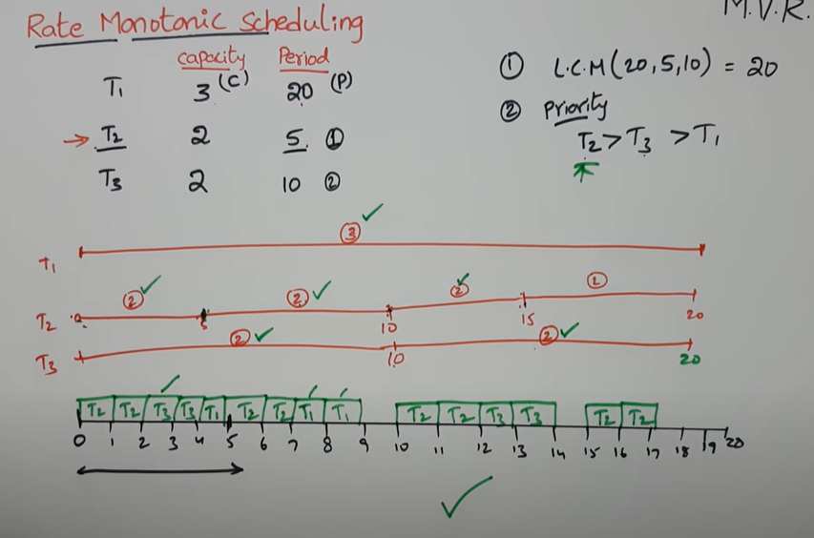
Example Rate Monotonic Scheduling
      period
T1 3 20 L.C.M=20
T2 2 5 priority T2>T3>T1
T3 2 10

Slide 68
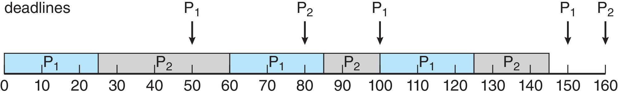
5.6.4.Earliest Deadline First Scheduling (EDF)
Earliest deadline first (EDF) is a dynamic priority scheduling algorithm that is used to place processes in a priority queue.
Whenever a scheduling event occurs (e.g., thread finishes, grabs a mutex) the queue will search for the processes closest to its deadline, البحث عن العمليات الأقرب إلى الموعد النهائي ، and that process will be the next to be scheduled for execution.

Slide 69
5.6.4.Earliest Deadline First Scheduling (EDF)XX
Priorities are assigned according to deadlines:
  The earlier the deadline, the higher the priority
  The later the deadline, the lower the priority
However, whereas rate-monotonic scheduling allows P1 to preempt P2 at the beginning of its next period at time 50, EDF scheduling allows process P2 to continue running.
Recall that P1 has values of p1 = 50 and t1 = 25 and that P2 has
values of p2 = 80 and t2 = 35.

Slide 70
5.6.4.Earliest Deadline First Scheduling (EDF)
P2 now has a higher priority than P1 because its next deadline (at time 80) is earlier than that of P1 (at time 100).
Thus, both P1 and P2 meet their first deadlines. Process P1 again begins running at time 60 and completes its second CPU burst at time 85, also meeting its second deadline at time 100.
P2 begins running at this point, only to be preempted by P1 at the start of its next period at time 100.
P2 is preempted because P1 has an earlier deadline (time 150) than P2 (time 160). At time 125, P1 completes its CPU burst and P2 resumes execution, finishing at time 145 and meeting its deadline as well. The system is idle until time 150, when P1 is scheduled to run once again.

Slide 71
5.6.5.Proportional Share Scheduling
Proportional Share Scheduling is a type of scheduling that preallocates certain amount of CPU time to each of the processes.
In a proportional share algorithm every job has a weight, and jobs receive a share of the available resources proportional to the weight of every job.
Proportional share schedulers operate by allocating T shares among all applications.
An application can receive N shares of time, thus ensuring that the
application will have N∕T of the total processor time.
As an example, assume that a total of T = 100 shares is to be divided among three processes, A, B, and C. A is assigned 50 shares, B is assigned 15 shares, and C is assigned 20 shares.
This scheme ensures that A will have 50 percent of total processor time, B will have 15 percent, and C will have 20 percent.

Slide 72
Proportional share schedulers must work in conjunction with an admission-control policy to guarantee that an application receives its allocated shares of time. An admission-control policy will admit a client requesting a particular number of shares only if sufficient shares are available.
يجب أن يعمل مجدولو الأسهم التناسبية جنبا إلى جنب مع سياسة مراقبة القبول لضمان حصول الطلب على حصصه المخصصة من الوقت. لن تسمح سياسة مراقبة القبول للعميل بطلب عدد معين من الأسهم إلا في حالة توفر أسهم كافية.
In our current example, we have allocated 50 + 15 + 20 = 85 shares of the total of 100 shares. If a new process D requested 30 shares, the admission controller would deny D entry into the system.
في مثالنا الحالي ، خصصنا 50 + 15 + 20 = 85 سهما من إجمالي 100 سهم. وإذا طلبت عملية جديدة دال 30 سهما، فإن مراقب القبول سيرفض دخول دال إلى النظام.

Slide 73
lecture

Slide 74
Proportional Share Scheduling
T shares are allocated among all processes in the system
An application receives N shares where N < T
This ensures each application will receive N / T of the total processor time

